Slide 1
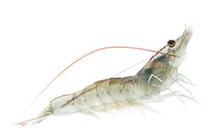
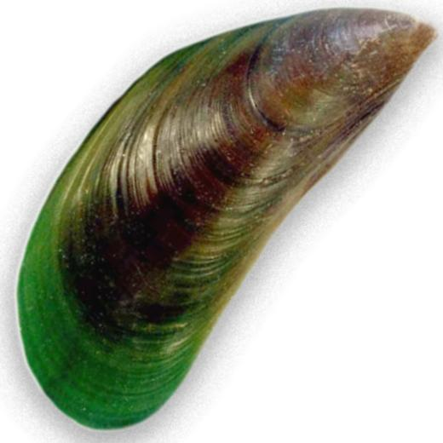
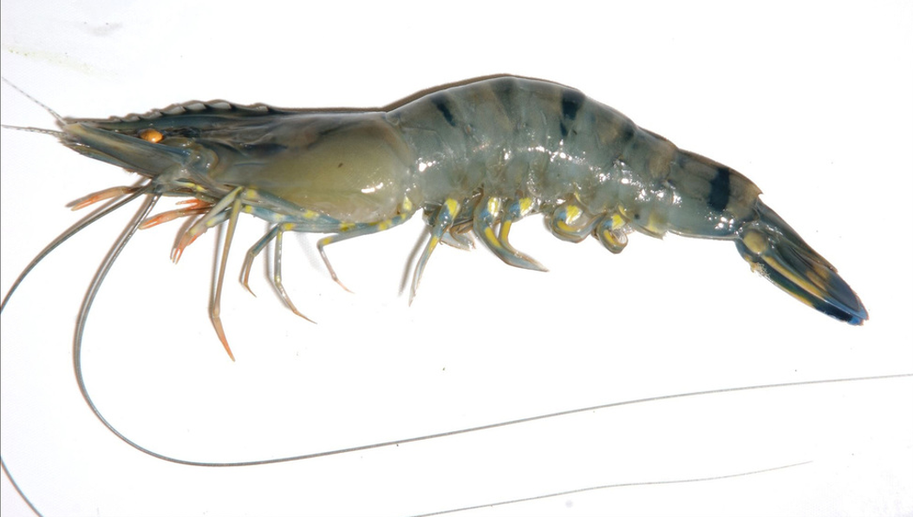
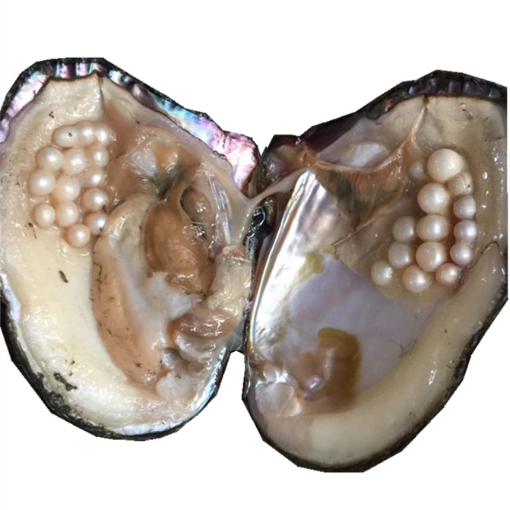
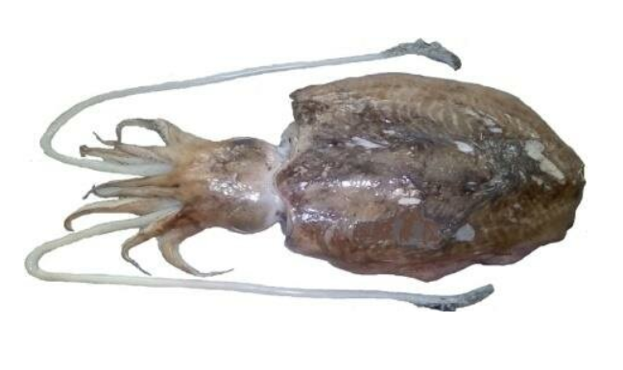
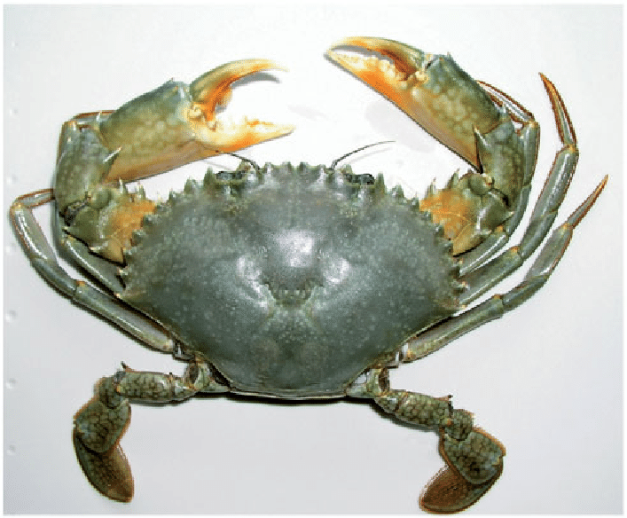
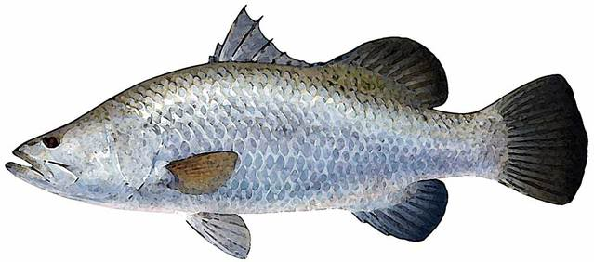
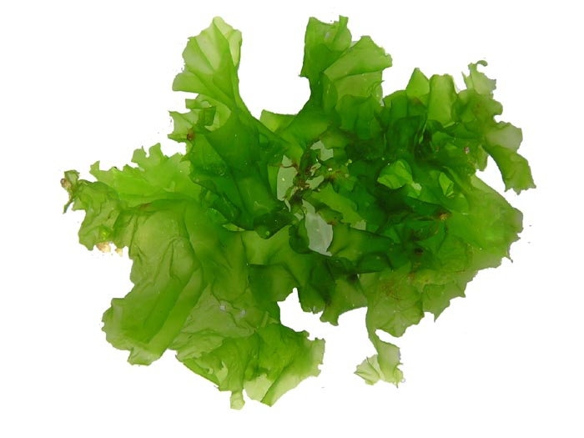
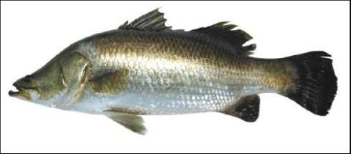
WELCOME TO
NAAC PEER TEAM
Department of Marine Living Resources
College of Science & Technology
Andhra University
Visakhapatnam

Slide 2
Vision
To produce trained man power in the fields of Fisheries,
Aquaculture and Marine Biotechnology with required skill set
to cater the needs of the industry and Academia and also to
accomplish Blue economy & Blue justice.
MISSION
Development of a strong knowledge hub with world class
equipment through innovative teaching methods by eminent and
experienced faculty. Also to impart required skill set through
hands on trainings.

Slide 3
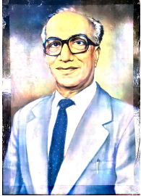
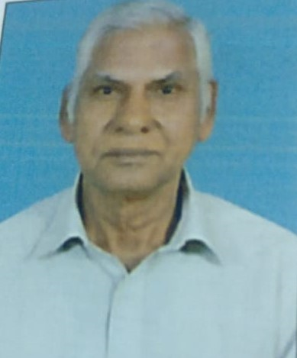
DEPARTMENT PROFILE
1976, Founder Members: Prof. S. Dutt & Prof. K. V. Ramana Murty
YEAR OF ESTABLISHMENT :
Prof. S. Dutt
Prof. K. V. Ramana Murty
PG & RESEARCH PROGRAMMMES OFFERED
S. No | Course | Subject | Intake/year
1 | M. Sc. | Marine Biology and Fisheries | 36
2 | M. Sc. | Coastal Aquaculture and Marine Biotechnology | 36
3 | M. Sc. | Marine Biotechnology | 20
4 | Ph.D. | Marine Living Resources | 8

Slide 4
ACHIEVEMENTS OF THE DEPARTMENT
RESEARCH PUBLICATIONS (2017-2022):
Total No. of Publications : 58
National : 22
International : 36
Current Researchers:
PDRF (DST-Women Scientist) : 1 Ph. D (Full Time) Scholars : 13
(DST INSPIRE -1, CSIR-JRF - 1)
Ph. D (Part Time) Scholars : 9
Ph. D (EMR) Scholars : 3

Slide 5
RESEARCH & CONSULTANCY GRANTS:
Major Research Areas : Fish Taxonomy & Biology, Hatchery Technology, Aquaculture, Fish Nutrition, Fish Pathology,
Marine Ecology, Marine Bio-deterioration, Marine algae, Marine Biotechnology and Marine Microbiology
S. No | Faculty | Title of the Project | Funding agency | Amount (Rs. in lakhs) | Whether Principal Investigator/Co-investigator | Status(Ongoing/Completed/ Applied)
1. | Prof. P. Janakiram | EC’s- Eco Marine Project-– ‘ Building a comprehensive mechanism for preserving Marine Ecosystems and life from the negative consequences of climate change and disposal of plastic debris. | European Commission | 111.0 | Principal Investigator | 2021-2024.
 |  | ”In- situ water quality monitoring , data collection and analysis of automated buoy system for Visakhapatnam coast Andhra Pradesh” for the period | NCCR-MoES project- | 185.0 | Principal Investigator | 2022- 2026
2. |  | Emerging Diseases in Penaeus vannamei culture systems with special emphasis on Microsporidiosis | UGC Seed Money | 28.00 | Principal Investigator | 2019-2021.
 |  | Emerging Diseases in Penaeus vannamei culture systems with special emphasis on Microsporidiosis | UGC Seed Money | 28.00 | Principal Investigator | 2019-2021.
3.
4. | Prof. P. Yedukondala Rao | Marine baseline monitoring for Gangavaram port- water and sediment quality | Adani Gangavaram port, Visakhapatnam | 16.99 | Consultant | Completed, Feb 2022- Feb, 2023.
 |  | “Impact of pollution study on nutrients of marine fisheries in Visakhapatnam by nuclear analytical techniques” | DST-SERB | 24.00 | Co-Investigator | Completed 05-2018 to 12-2021
 |  | “Inventorying and bar-coding of venomous and poisonous fishes of east coast of India” | MoES-CMLRE IT IS | 45.03 | Co-Investigator | Completed 09-2013 to 12-2017
5.
6 | Dr. K Umadevi | Bioinformatics Infrastructure facility | DBT | 30.0 | Coordinator | 2017-20
 |  |  | Total | 440.02

Slide 6
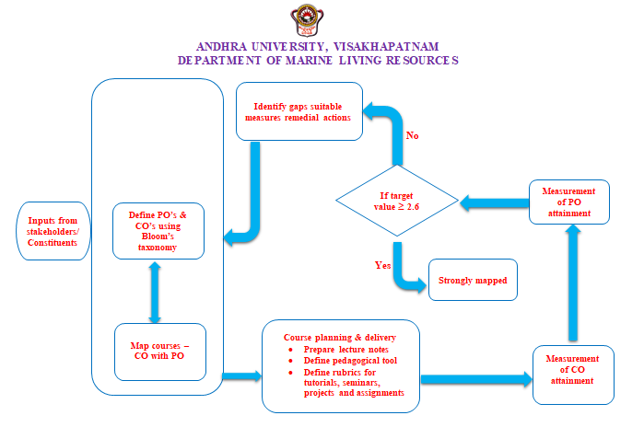
CURRICULAR ASPECTS
OBE framework : Followed as per the University norms.

Slide 7
POs
M. Sc., Marine Biology and Fisheries
PO1. Obtain knowledge in various aspects of marine ecosystems, physical and chemical
parameters, biological oceanography and biostatistics.
PO2. Acquire knowledge in various aspects of coastal zone management, biology of
marine organisms, fish physiology and fisheries science
PO3. Obtain knowledge in fishing technology and fishery management, aquaculture,
fish nutrition and feed technology, coastal marine pollution and bio-deterioration.
PO4. Acquire knowledge of fish processing and preservation, fishery economics and
extension, application of biotechnology to aquaculture for best culture production
of food species.
PO5. Skilled, technical manpower will be produced to serve the fisheries sector,
aquaculture sector, marine fisheries and aquaculture research institutes and to the
colleges to teach marine biology and fisheries courses.

Slide 8
DEPARTMENT OF MARINE LIVING RESOURCES, ANDHRA UNIVERSITY
M.Sc. Marine Biology and Fisheries (With effect from 2021-2022 admitted batches)
I Semester |  | II Semester
1.1 Physical and Chemical Oceanography |  | 2.1 Estuaries and Coastal Zone Management
1.2 Biological Oceanography |  | 2.2 Biology of Marine Organisms
1.3 Marine Ecology |  | 2.3 Fish Physiology
1.4 Biostatistics |  | 2.4 Fishery Science
III Semester |  | IV Semester
3.1 Fishing Technology and Fishery Management |  | 4.1 Fish Processing Technology
3.2 Aquaculture |  | 4.2 Fishery Economics and Extension
3.3 Fish Nutrition and Feed Technology |  | 4.3 Aquaculture Biotechnology
3.4 Marine Pollution & Bio-deterioration |  | Project Work
Intellectual Property Rights (Value added Course) |  | Research Methodology(Value added Course)

Slide 9
Document

Slide 10
M.Sc. Coastal Aquaculture and Marine Biotechnology
PO1. Acquire sound knowledge on oceanography, marine biology, culture of fishes,
crustaceans, molluscs and seaweeds, postharvest technology, design and
construction of fish/shrimp farms.
PO2. Obtain knowledge on farm management including soil, water and feed. Seed
production through induced breeding and operation of fish/shrimp hatcheries
and also the basics of marine microbiology.
PO3. Acquire knowledge on aquaculture nutrition, application of genetics in
aquaculture, molecular biology, marine pollution and bio-deterioration.
PO4. Acquire knowledge on fish pathology, immunology, bio-technological
applications in aquaculture, isolation and purification of bioactive marine natural
products.
PO5. Understand the concepts of marine ecology, aquaculture, nutrition for
aquaculture species, induced breeding, seed production and pathology through
hands on training, field visits and project works.

Slide 11
DEPARTMENT OF MARINE LIVING RESOURCES, ANDHRA UNIVERSITY
M.Sc. Coastal Aquaculture and Marine Biotechnology(With effect from 2021-2022 admitted batches)
I Semester |  | II Semester
1.1Oceanography and Marine Biology |  | 2.1 Molluscan & Seaweed Farming
1.2 Fin Fish Culture |  | 2.2 Soil and Water Quality Management in Aquaculture
1.3 Crustacean Farming |  | 2.3 Seed Production and Hatchery Management
1.4 Aquaculture Engineering |  | 2.4 Marine Microbiology
III Semester |  | IV Semester
3.1 Biochemistry and Fish Nutrition |  | 4.1 Fish Pathology and Immunology
3.2 Genetics in Aquaculture |  | 4.2 Marine Biotechnology
3.3 Molecular Biology |  | 4.3 Bioactive Marine Natural Products
3.4 Marine Pollution and Bio-deterioration |  | Project Work
Intellectual Property Rights (Value added Course) |  | Research Methodology(Value added Course)

Slide 12
Document

Slide 13
M.Sc. Marine Biotechnology
PO1. Masters the concepts in oceanography, Biochemistry, Molecular Biology,
Reproductive Physiology and Endocrinology of Fish
PO2. Acquire knowledge on Coastal Aquaculture; apply the principles of genetics,
Marine Microbiology and Tissue Culture on aquaculture species.
PO3. Understand the principles of Health Management in Aquaculture, Immunology,
Enzymology and Enzyme Technology and can apply them in Industry.
PO4. Masters the concepts in Marine Pollution and Bio-deterioration.
PO5. Understand the applications of Biotechnology and Genetic Engineering in
Aquaculture, Bioactive Marine Natural Products and their applications.

Slide 14
DEPARTMENT OF MARINE LIVING RESOURCES, ANDHRA UNIVERSITY
M.Sc. Marine Biotechnology (With effect from 2021-2022 admitted batches)
I Semester |  | II Semester
1.1 Oceanography and Marine Biology |  | 2.1 Coastal Aquaculture
1.2 Biochemistry |  | 2.2 Fish Genetics
1.3 Reproductive Physiology and Endocrinology |  | 2.3 Marine Microbiology and Microbial Technology
1.4 Molecular Biology |  | 2.4 Cell & Tissue Culture
III Semester |  | IV Semester
3.1 Health Management in Aquaculture |  | 4.1 Applications of Biotechnology in Aquaculture
3.2 Immunology |  | 4.2 Genetic Engineering
3.3 Enzymology and Enzyme Technology |  | 4.3 Bioactive Marine Natural Products
3.4 Marine Pollution and Bio-deterioration |  | Project Work
Intellectual Property Rights (Value added Course) |  | Research Methodology(Value added Course)

Slide 15
Document

Slide 16
Integration of Environmental Sustainability Human values in the Curriculum
Marine pollution & Bio-deterioration
Marine Ecology
Estuaries and coastal Zone management
Conservation of Marine organisms
Craft and gear
Fish processing & preservation
Eco-friendly aquaculture.

Slide 17
Teaching, Learning and Evaluation
Faculty list:
Name of Faculty Member | Designation | Specialization | No. of Ph. D’s Produced | No. of Publications | Workshops/ Seminars/ Conferences/ Training Programs attended | H -Index
Prof. P. Yedukondala Rao | Professor | Fish Taxonomy & Biology and Aquaculture | 9 | 9 | 4 | 6
Prof. P. Janakiram | Professor | Fish Health and Marine Microbiology | 4 | 8 | 4 | 7
Prof. K. Ramesh Babu | Professor | Marine Biology and Hatchery Technology for fish/shrimp | 6 | 17 | 2 | 9
Dr. C. Mamatha | Associate Professor | Marine Biology & Oceanography | - | 3 | 18 | -
Dr. K. Umadevi | Professor | Marine Ecology and Marine Algae | - | 1 | 6 | 1
Dr. A. K. Reddy | Professor (Emeritus) | Hatchery Management | 3 | 12 | 4 | 16
Dr. P. Rama Chandra Ganesh | Assistant Professor (C) | Marine Biotechnology | - | 6 | 167 | 6
Dr. I. R. Sirisha | Assistant Professor (C) | Coastal Aquaculture and Marine Biotechnology | - | 3 | 24 | 6

Slide 18
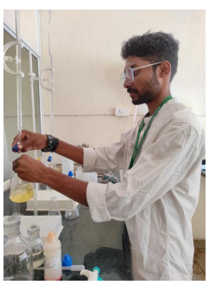
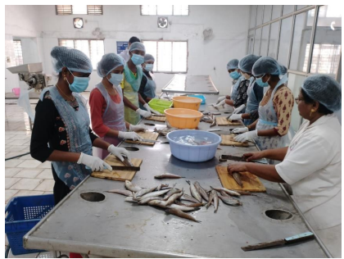
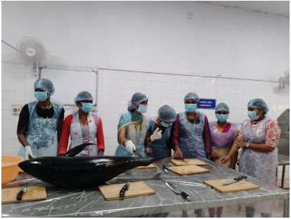
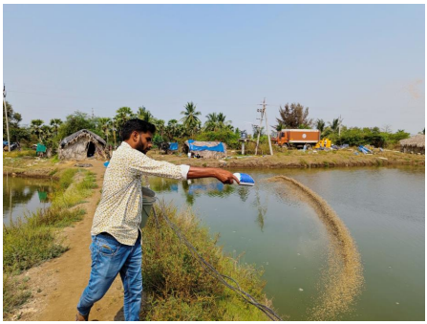
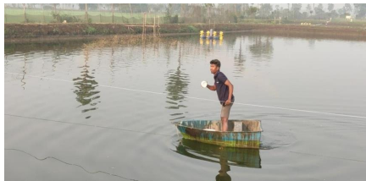
Courses with employability/Skill development/value added programmes offered
Intellectual Property Rights & Research Methodology
Student Project works
Fish Handling & Processing
Tuna Cutting
Water Analysis
Feed Distribution
Feed Distribution

Slide 19
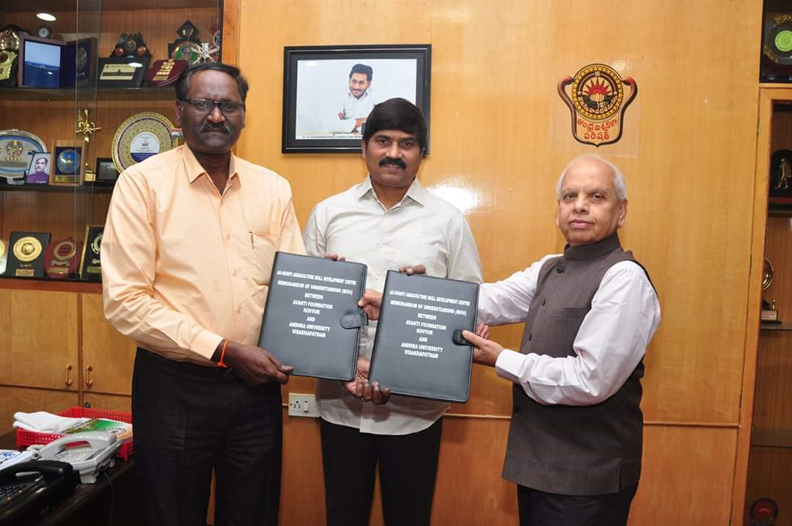
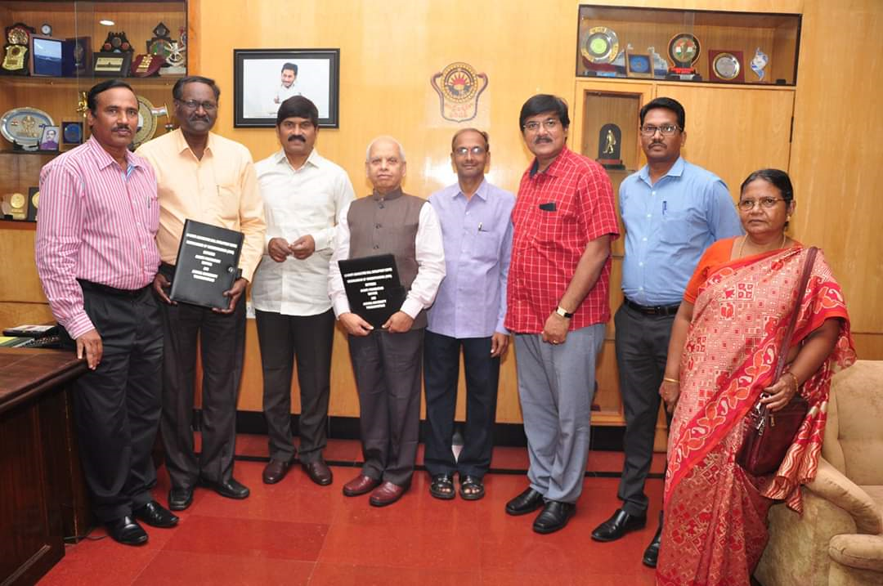
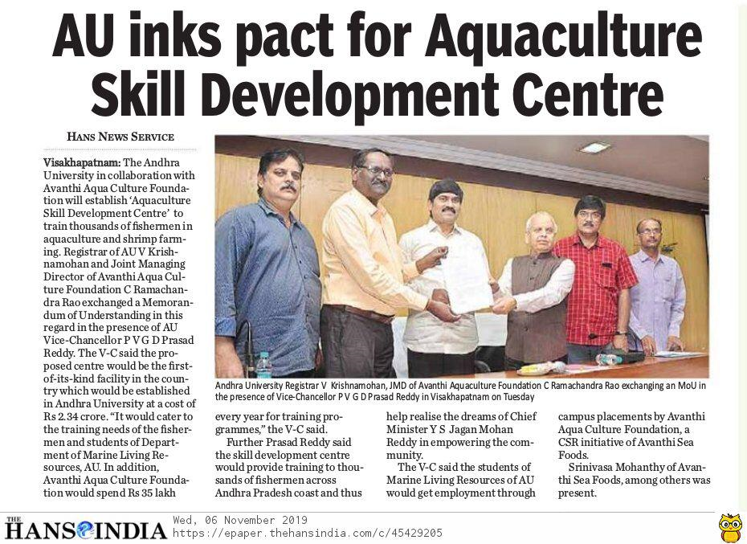
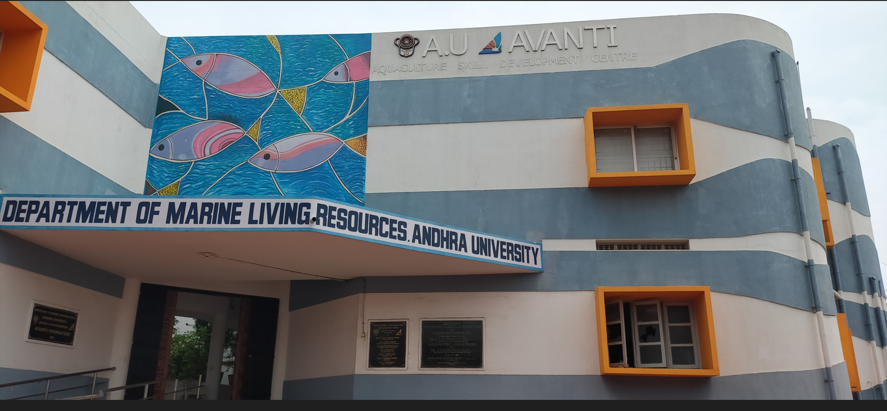
Skill Development
MoU’s : AU-Avanti Aquaculture Skill Development
Centre (2019)

Slide 20
No. of Skill Development Program’s Conducted : 2022-23
Sl. No | Name of the Skill Development Programme | Period | Target Group | No. Trained | No.of Days
1 | Better Management Practices in Shrimp Farming | 09thJuly- 11thJuly ,2022 | PG Students- MLR Dept, AU | 29 | 3
2 | Better Management Practices in Shrimp Farming | 19thJuly- 21thJuly ,2022 | PG Students, MLR Dept, AU | 42 | 3
3 | Better Management Practices in Shrimp Farming | 25thJuly- 27thJuly ,2022 | PG Students, MLR Dept, AU | 20 | 3
4 | Better Management Practices in Shrimp Farming | 8thAug- 10thAug,2022 | PG Students, Zoology Dept, AU | 29 | 3
5 | Better Management Practices in Shrimp Farming | 18thAug- 20thAug,2022 | PG Students, Zoology Dept, AU | 32 | 3
6 | Water & Soil Analysis & Disease Management in Shrimp Farming | 6thSept - 15thSept,2022 | Graduate Students, Dr V.S.Krishna Govt. Degree College, VSP | 22 | 10
7 | Water &Soil Analysis and Disease Management- Workshop – Expert : Dr Prapansak | 20.09.2022 | PG Students of MLR, Zoology, AU | 142 | 1
8 | Water &Soil Analysis and Disease Management- Workshop – Expert : Dr Prapansak | 22.09.2022 | Aqua Farners, Unemployed Youth, New Entrants of Aquaculture | 93 | 1
9 | Water &Soil Analysis and Disease Diagnosis of Fish& Shrimp in Aquaculture Ponds Management | 10thOct - 19thOct,2022 | Passed out PG,Graduates of ANU, ANU, Pydah College for Fisheries , Siddhardh Womens College, VJA | 23 | 10
10 | Histopathology & RT-PCR Techniues for Disease Diagnosis | 31st Oct - 5 Nov 2022 | Passed POut PG , Research SColars of AU & Nagarjuna University & Adikavi Nannyya University | 12 | 6
11 | Water & Soil and Microbiological Techniques for Disease diagnosis of Fish & Shrimp | 12th Nov- 21st Nov,2022 | Microbiology Graduate Students of Dr.V.S.Krishna Govt. Degree College , VSP | 25 | 10
12 | Water & Soil and Microbiology & RT-PCR Techniques for Disease diagnosis of Fish & Shrimp | 06th Dec - 15th Dec,2022 | PG Final Aquaculture Students of Adikavi Nannayya University | 18 | 10
13 | Water & Soil and Microbiology & RT-PCR Techniques for Disease diagnosis of Fish & Shrimp | 02nd January- 11th January,2023 | PG Final Aquaculture Students of AN U & Vikrama Simhapuri University | 21 | 10
14 | Water & Soil and Disease Diagnosis of Fish & Shrimp | 23rd January- 2nd February,2023 | PG AQuaculture Students of KGRL College of PG Courses, Bhimavaram | 20 | 10
15 | Water & Soil and Microbiology & RT-PCR Techniques for Disease diagnosis of Fish & Shrimp | 13th Feb-23rd Feb,2023 | PG AQuaculture Students of PRG College & Pydah College, Kakinada | 16 | 10
 | TOTAL |  |  | 544

Slide 21
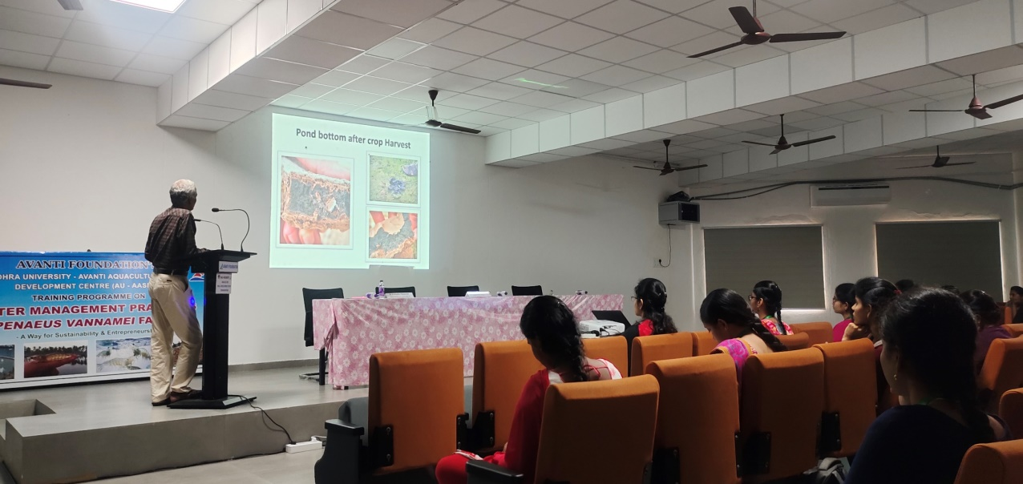
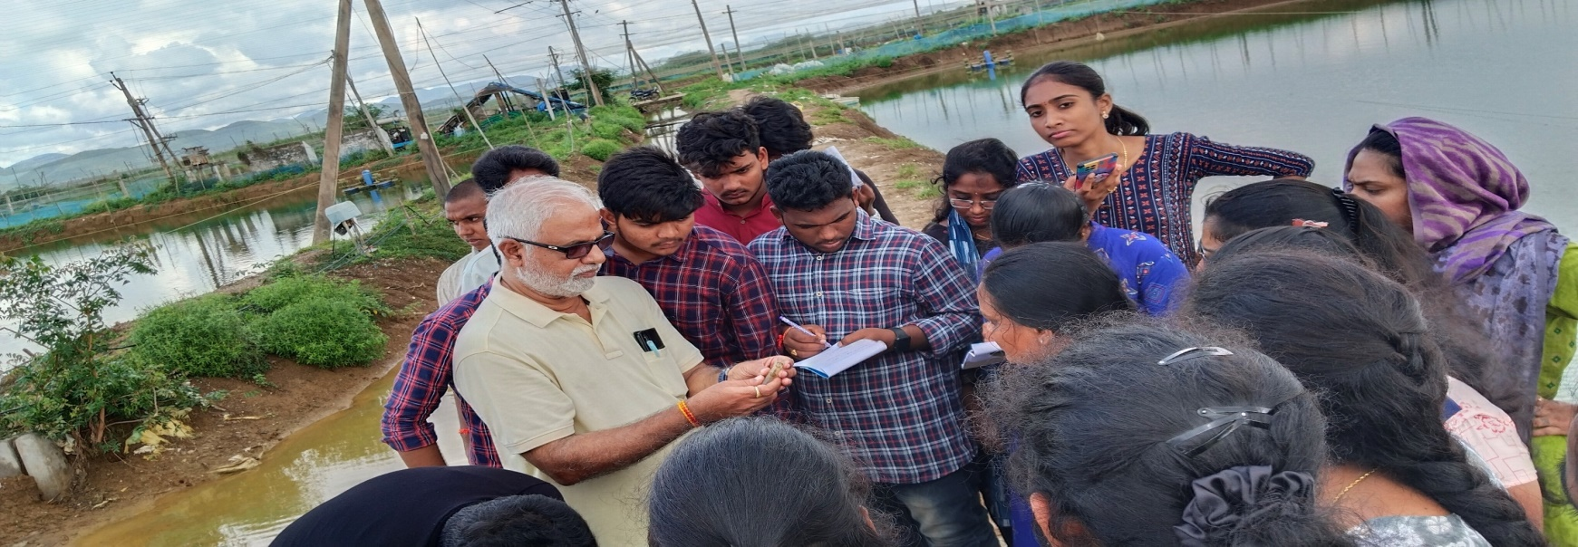
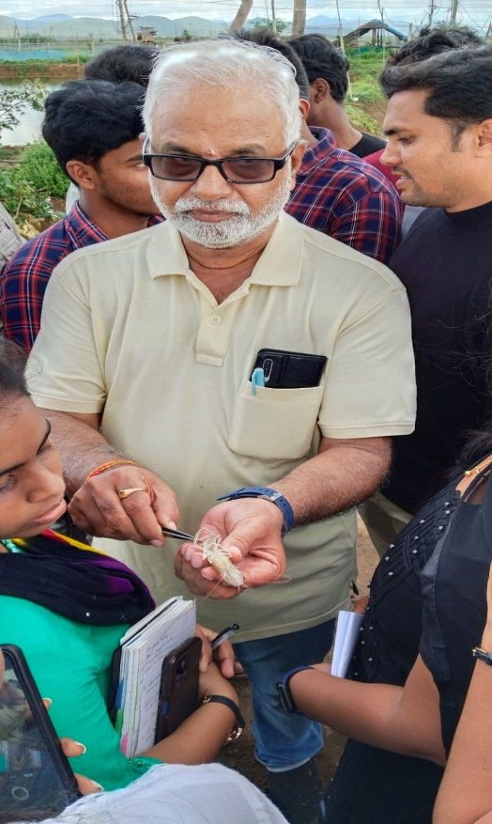
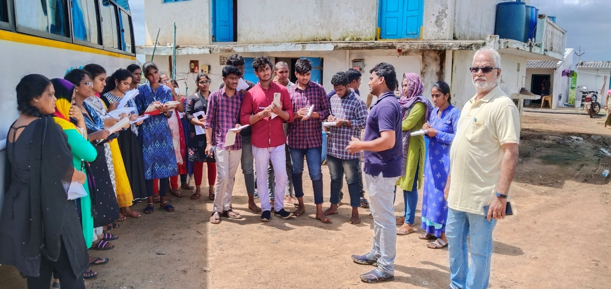
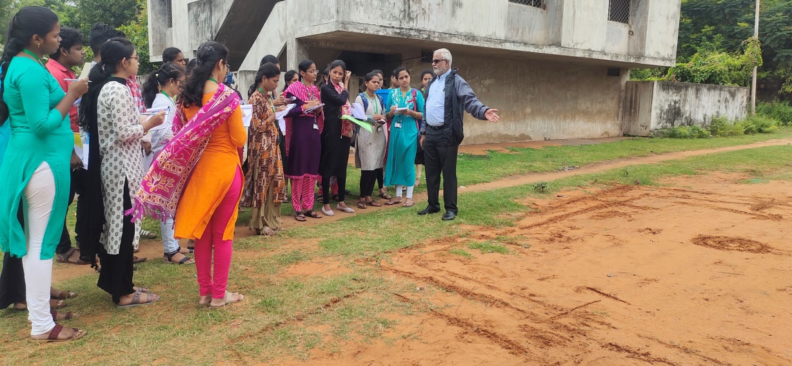

Slide 22
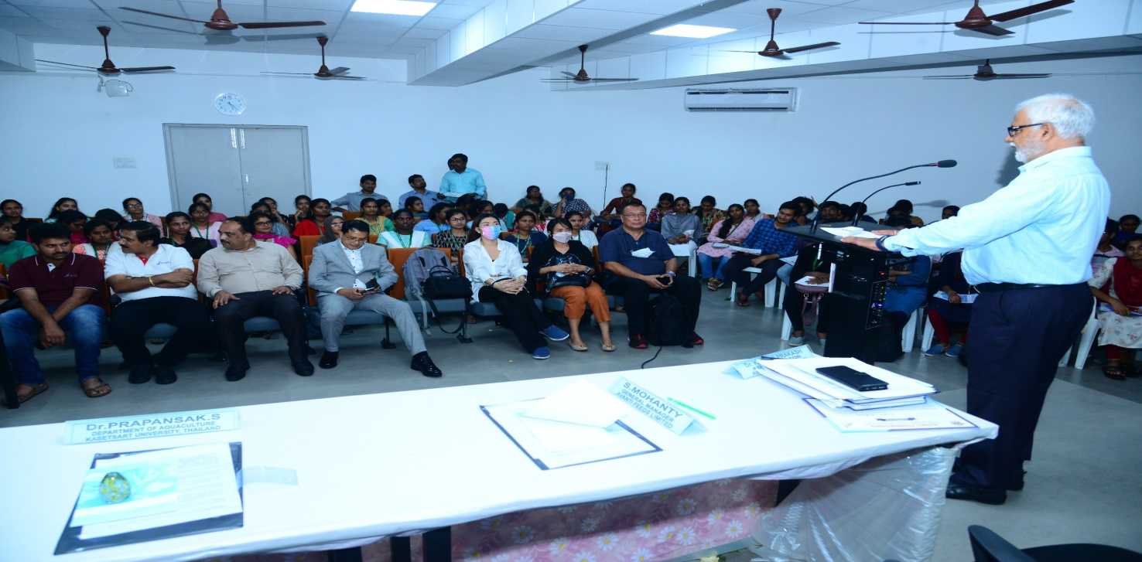
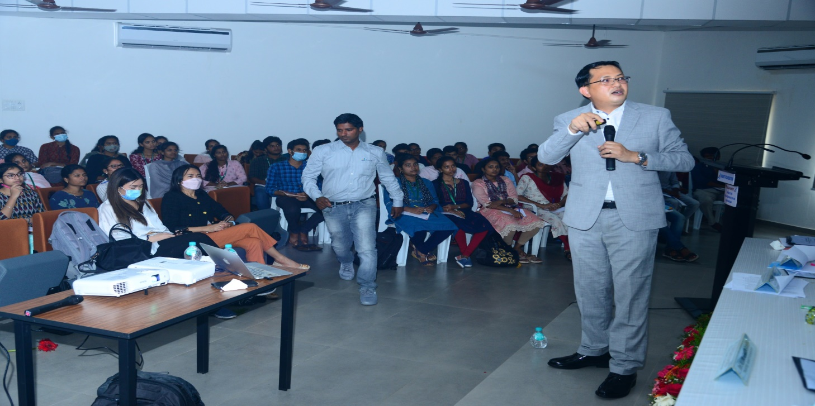
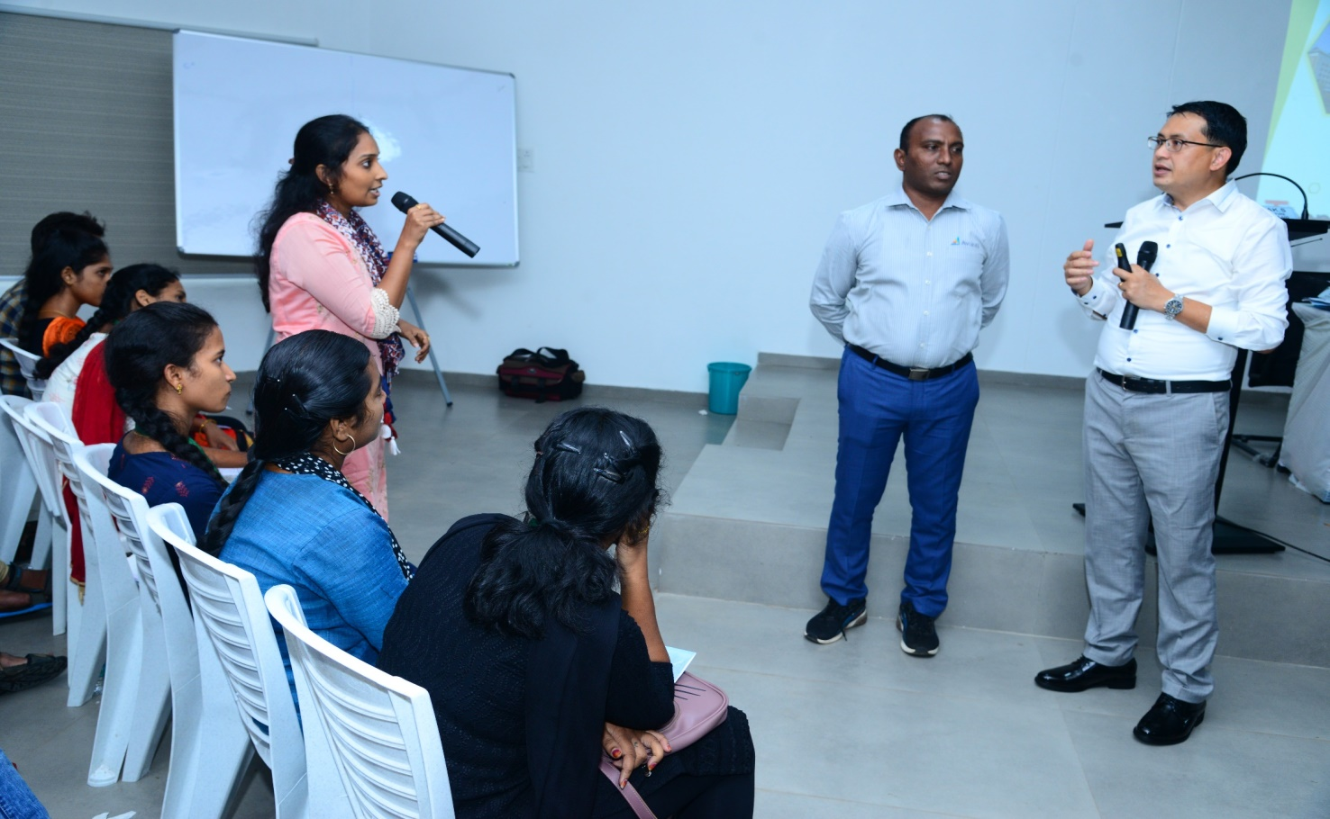
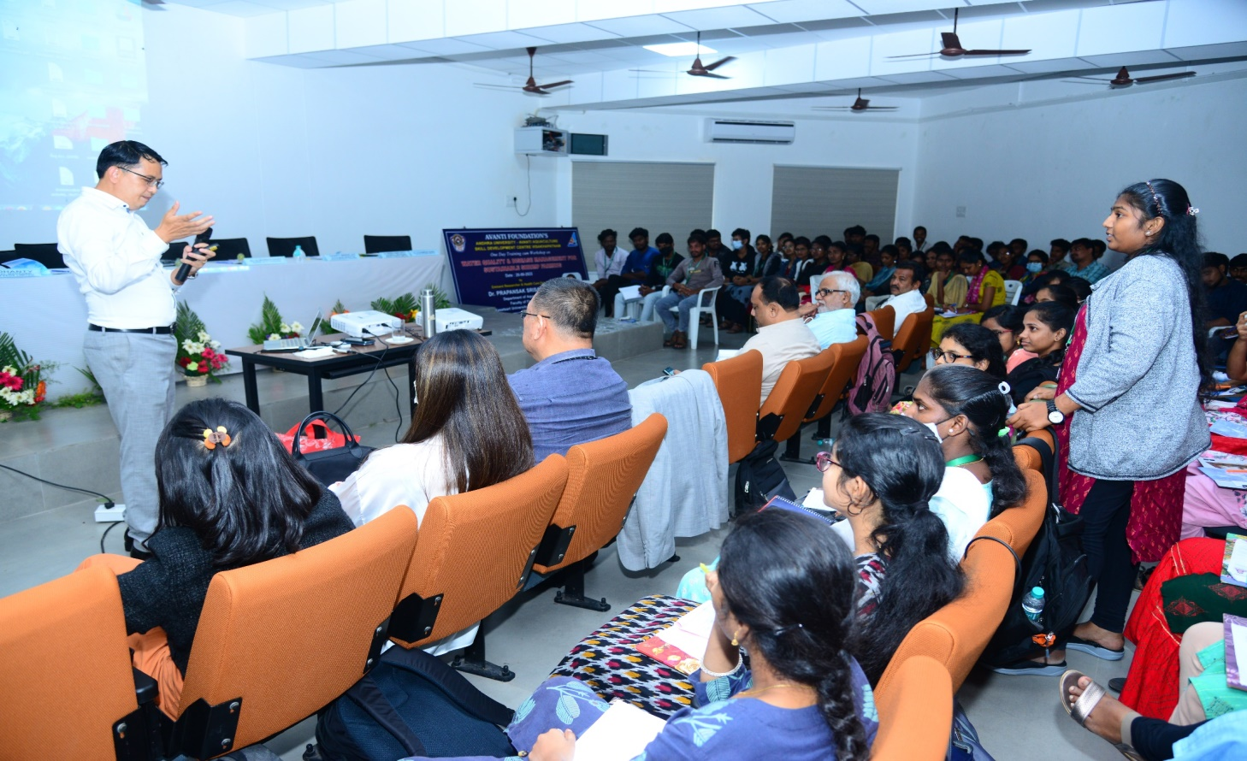

Slide 23
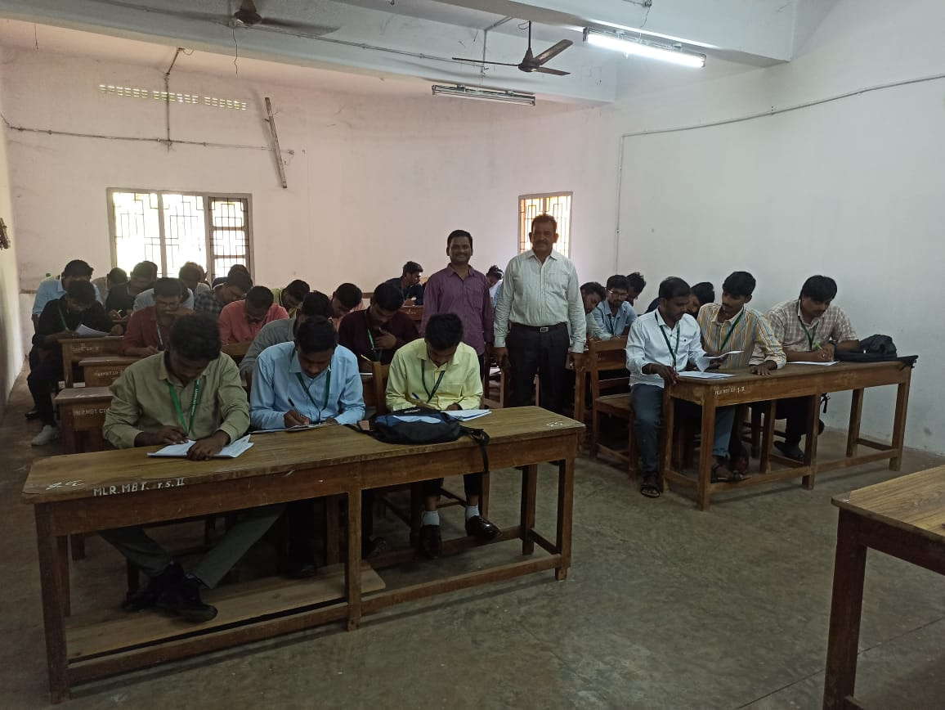
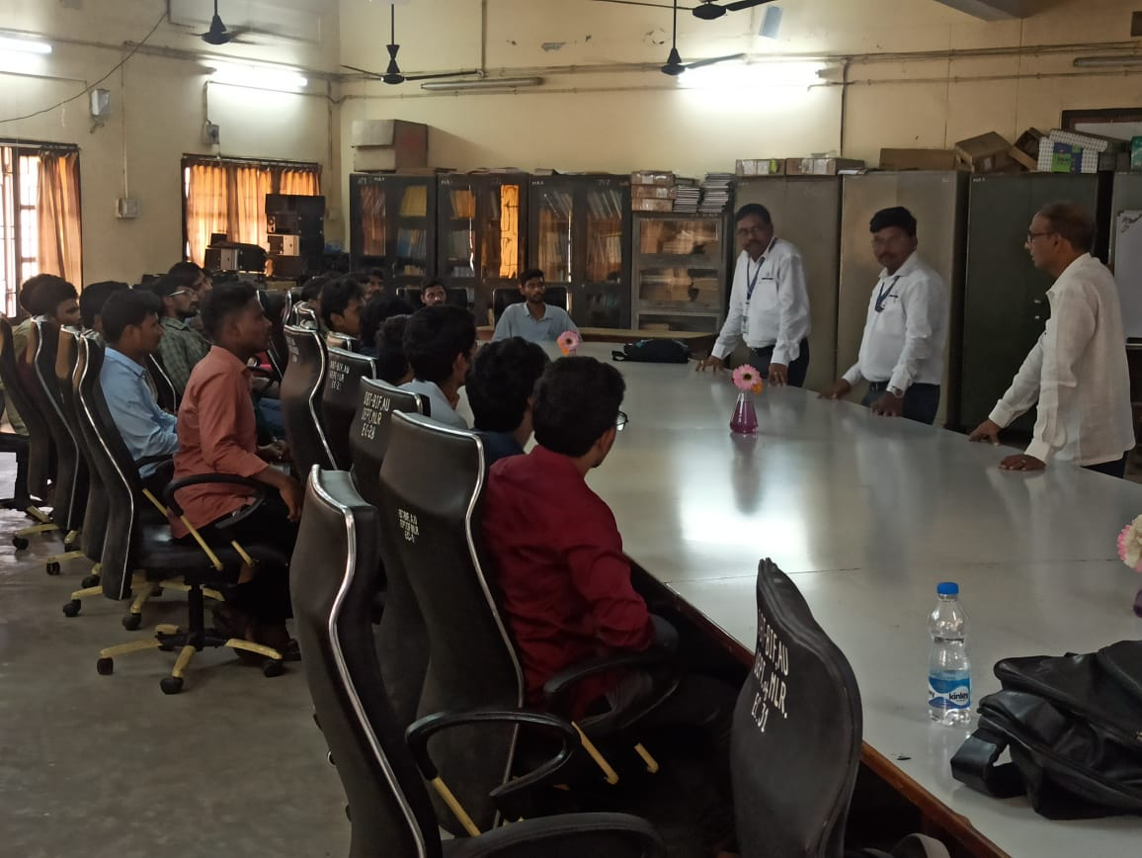
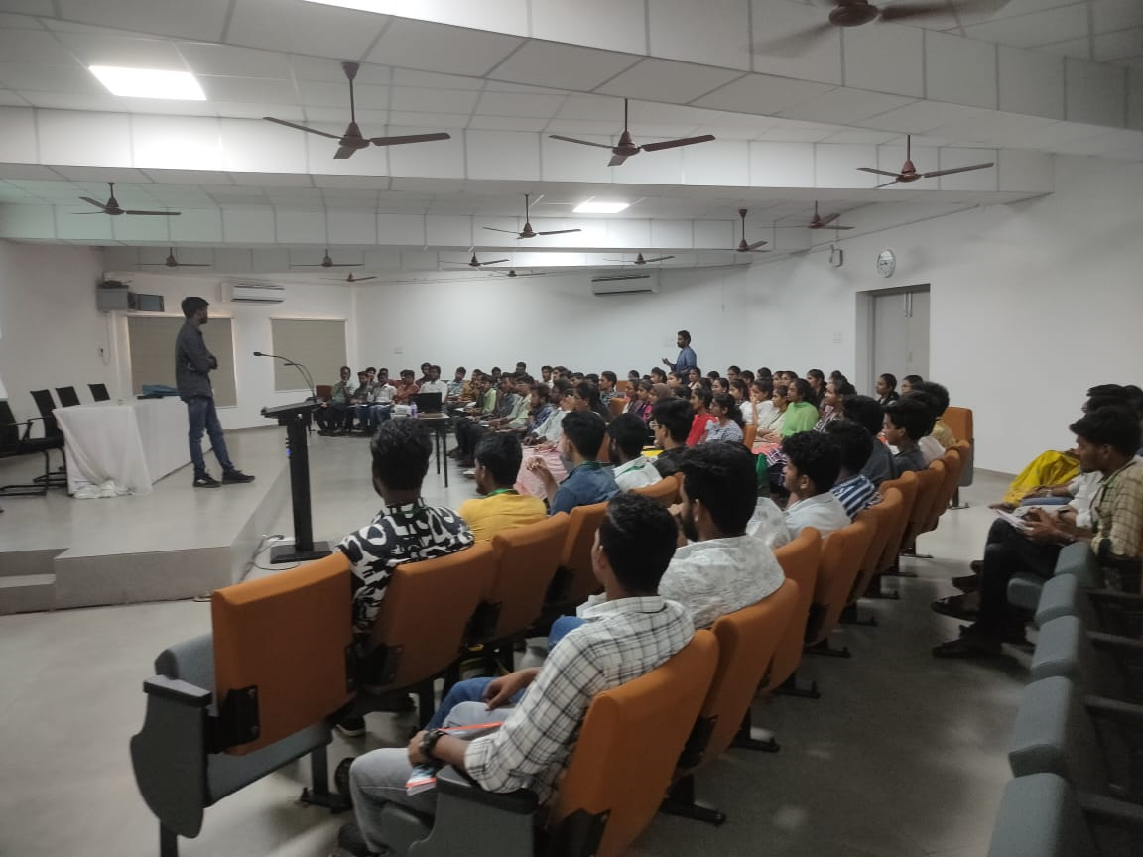
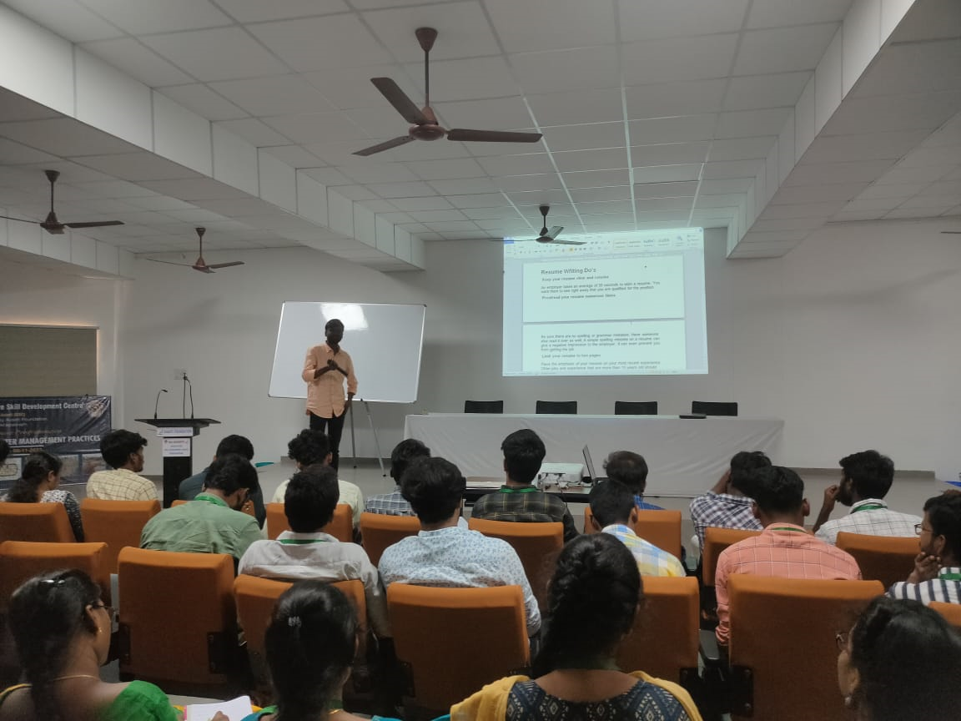
Career counselling/placement guidance

Slide 25
Recruiting Agencies and Salary Package
Year | Number of students attended | Name of student placed | Name of the companies | Pay package at appointment
2021-22 | 50 | 20 | CP, Avanti, Growel, IB & Processing Plants | 4.0-3.5 LPA
2020-21 | 49 | 46 | CP, Avanti, Growel, IB & Processing Plants | 3.5-3.0 LPA
2019-20 | 49 | 48 | CP, Avanti, Growel, IB & Processing Plants | 3.5-3.0 LPA
2018-19 | 57 | 56 | CP, Avanti, Growel, IB & Processing Plants | 3.25 -3.0 LPA
2017-18 | 50 | 49 | CP, Avanti, Growel, IB & Processing Plants | 3.0 -2.5 LPA

Slide 26
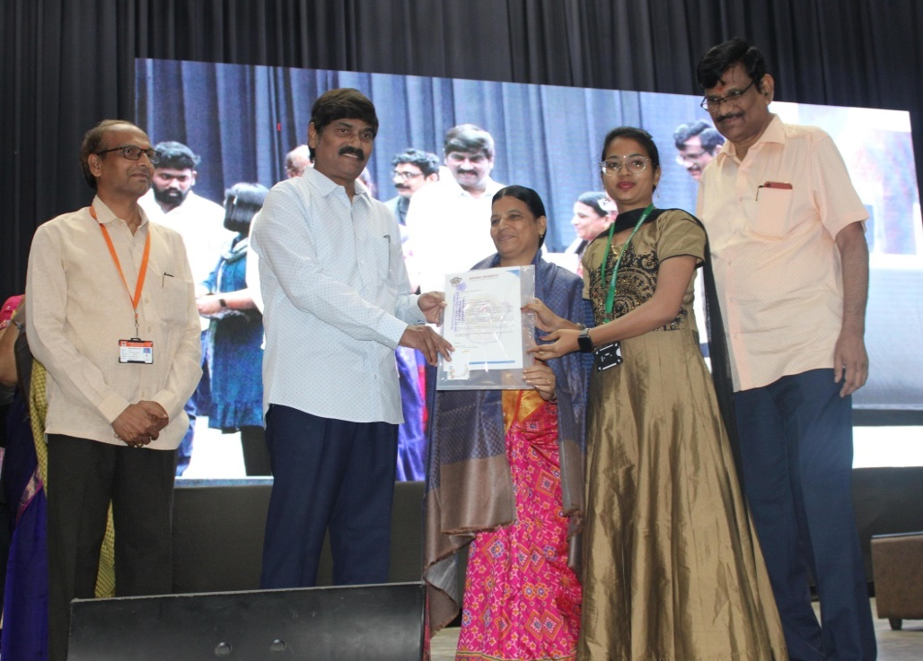
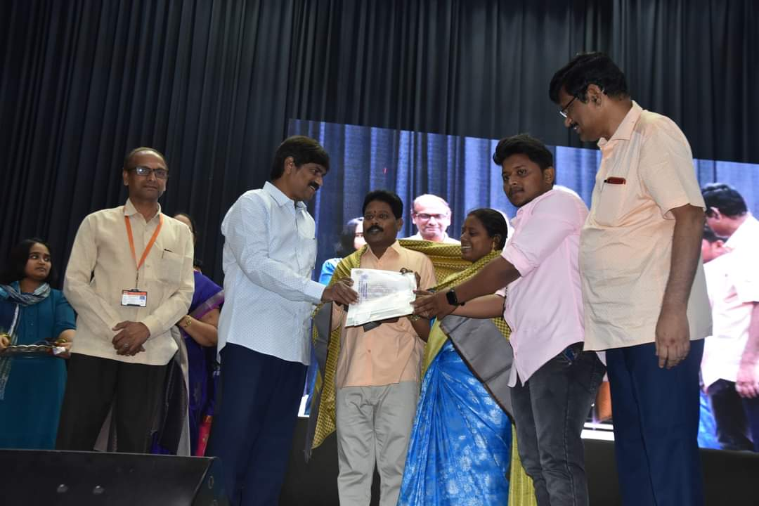
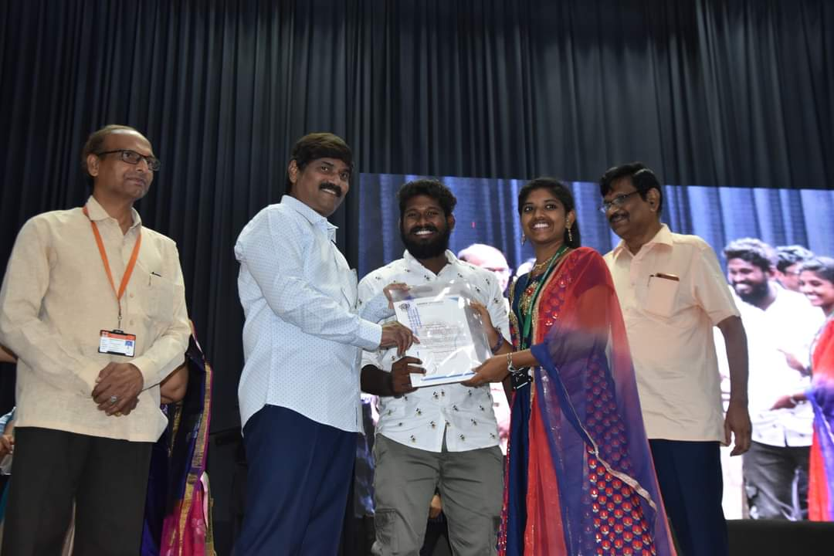
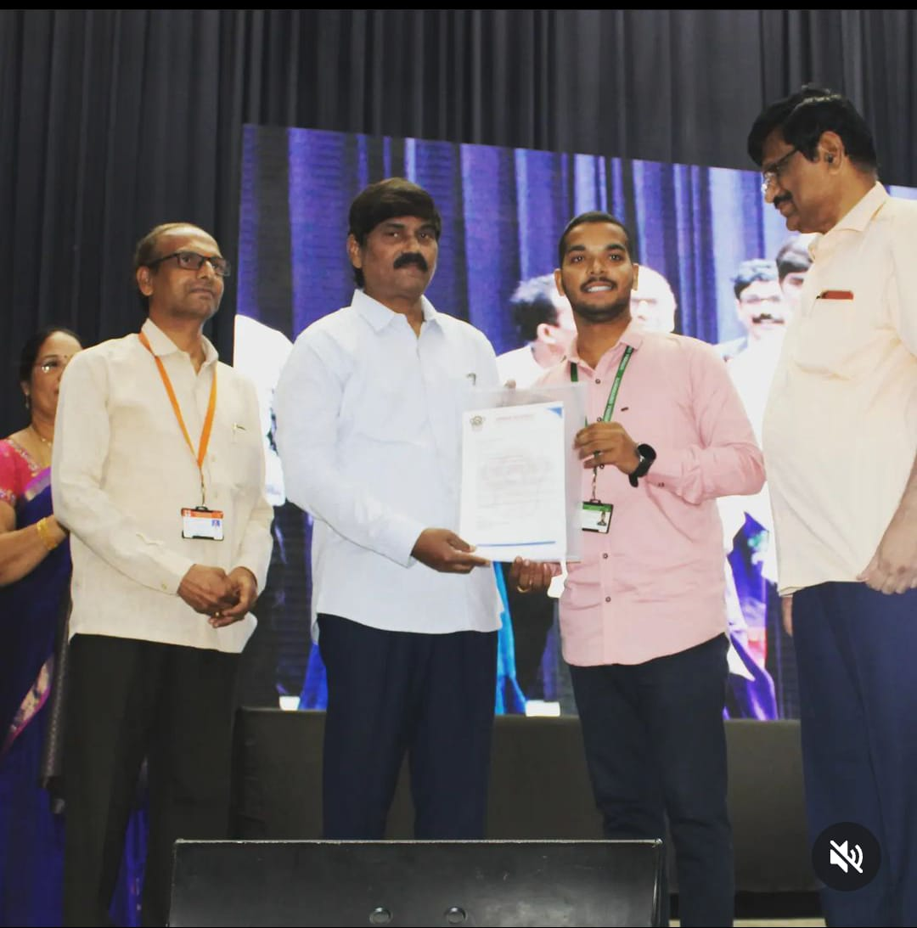
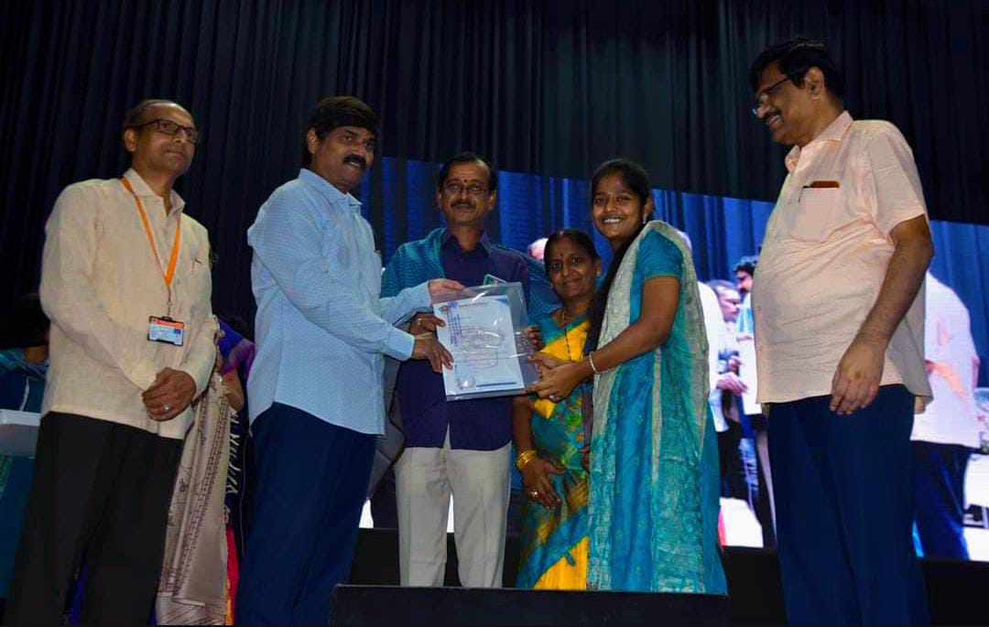
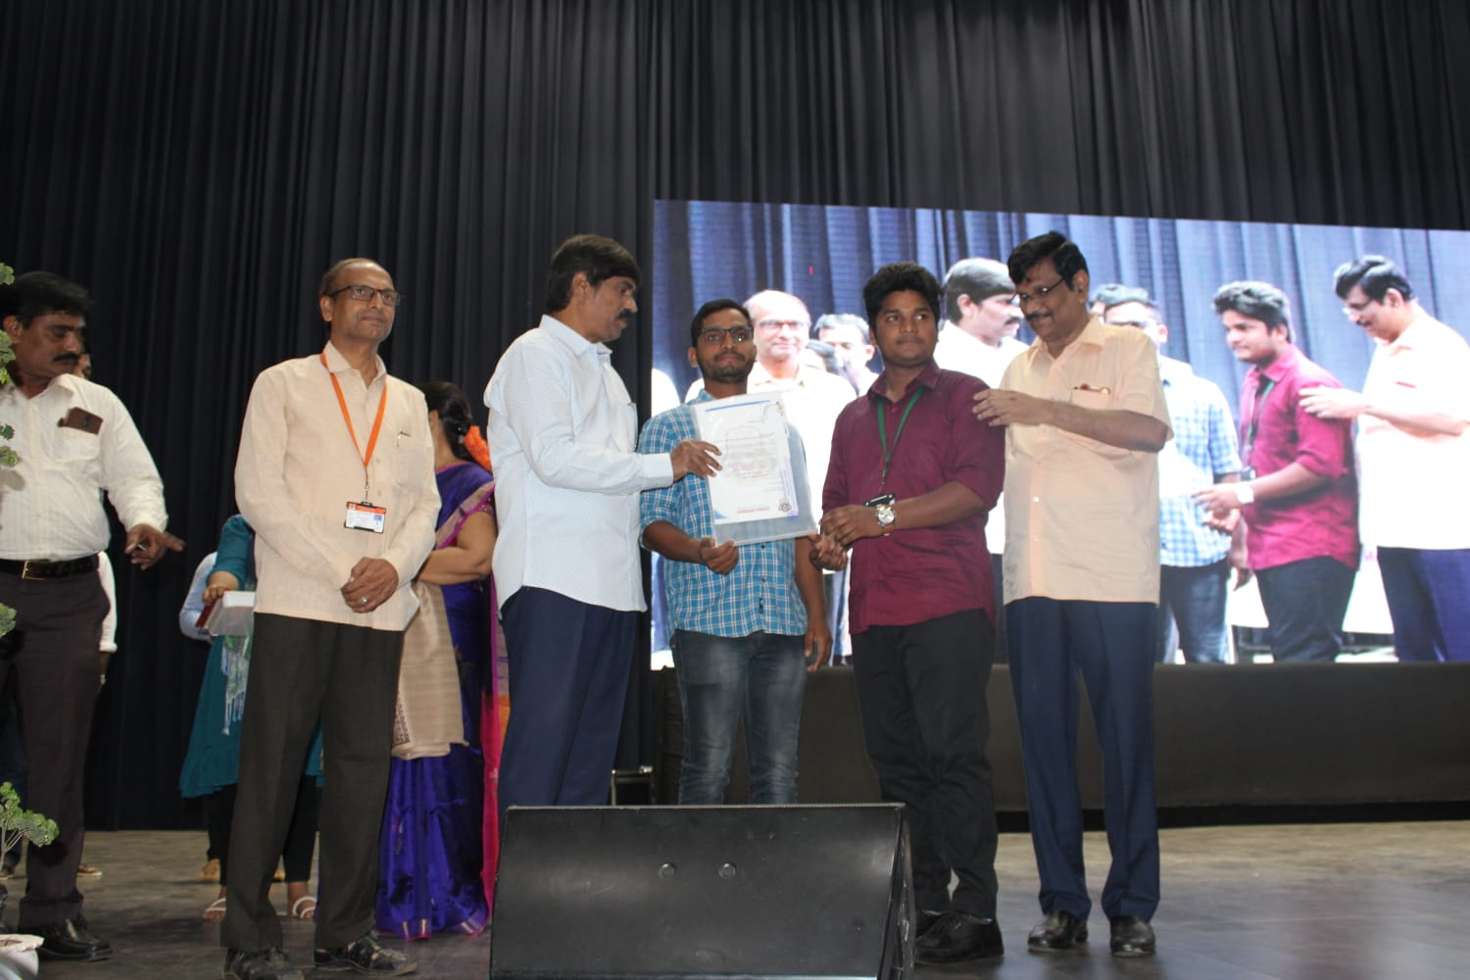

Slide 27
Feedback for curriculum collected and analysed report
Document

Slide 28
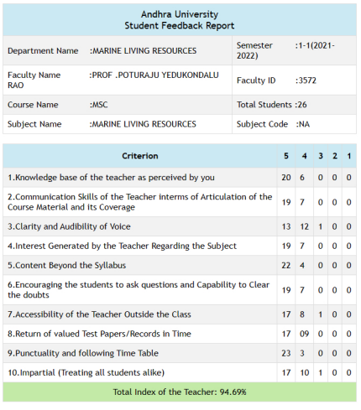
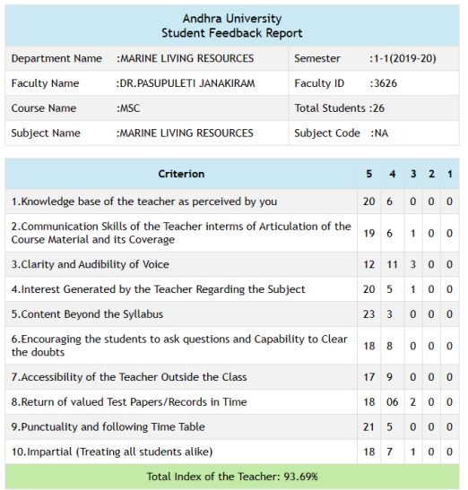
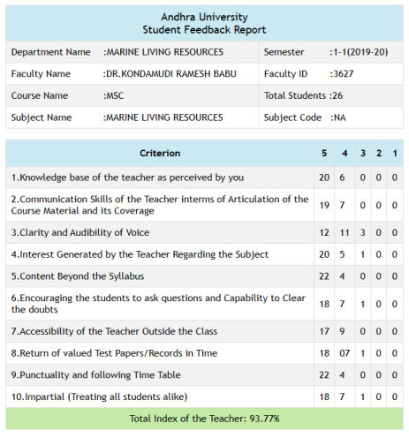
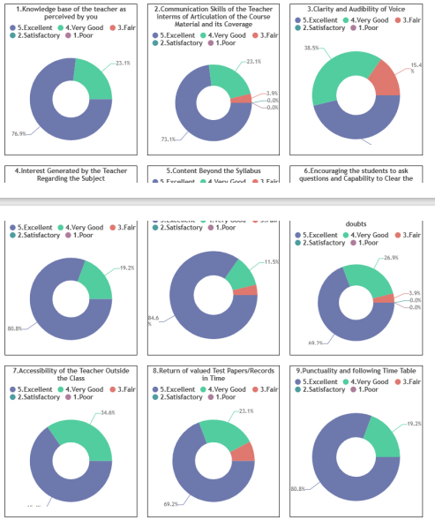
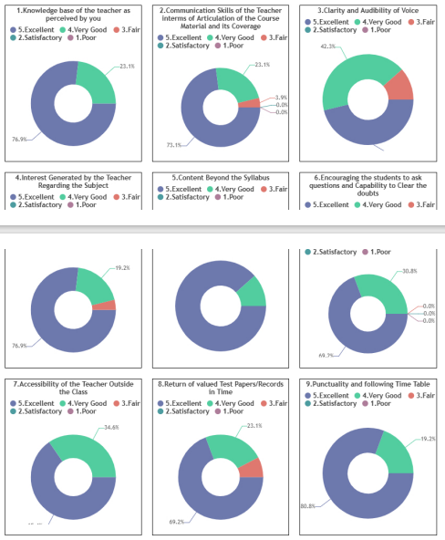
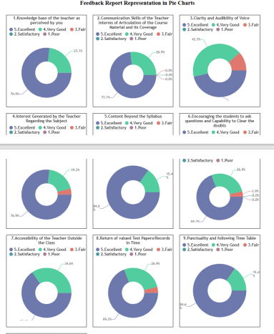
Student Feed Back on Faculty

Slide 29
Students Diversity & Demand Ratio
Year | Male | Female | SC | ST | OBC | General | National Integration | Foreign | Total students | Demand Ratio
2017-’18 | 34 | 14 | 12 | 2 | 26 | 8 | 1 | - | 48 | 5:1
2018-’19 | 33 | 22 | 10 | 3 | 33 | 9 | 1 | - | 55 | 5.4:1
2019-’20 | 26 | 22 | 9 | 4 | 27 | 8 | 1 | - | 48 | 5.6:1
2020-’21 | 27 | 22 | 8 | 6 | 26 | 8 | 1 | 1 | 49 | 5.9:1
2021-’22 | 64 | 28 | 21 | 6 | 52 | 13 | 1 | - | 92 | 6:1
Student Strength : 92 (MBF- 41, CAMB – 31, MBT- 20)

Slide 30
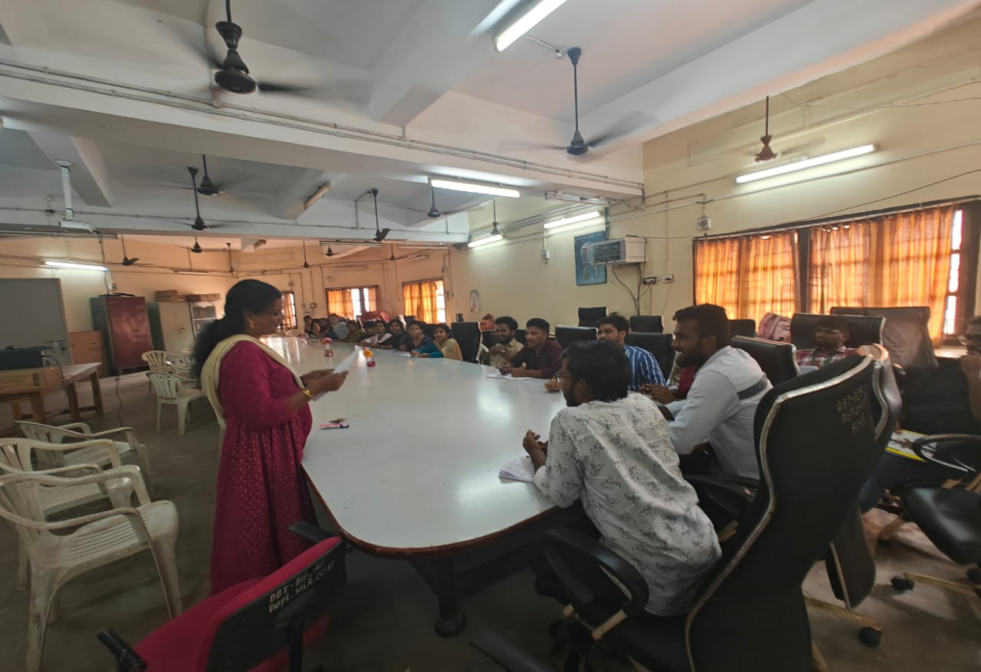
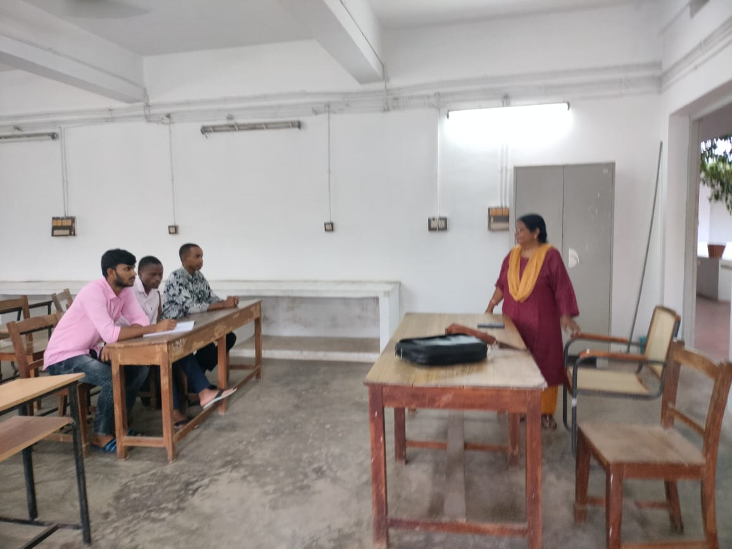
Students categorisations (Fast learners/ Average learners/ slow learners) (CGPA ≤ 5 = Slow learners; > 5 <7 = Medium learners; > 7 = Fast learners)
Year | Fast learners | Medium learners | Slow learners | Total students
2017-2018 | 30 | 18 | - | 48
2018-2019 | 35 | 20 | - | 55
2019-2020 | 27 | 21 | - | 48
2020-2021 | 38 | 11 | - | 49
2021-2022 | 69 | 20 | 3 | 92
Programmes for Slow Learners: Tutorial classes

Slide 31
Action taken for Slow learners
Remedial classes
Assignments/ Seminars/Group Discussions
Individual Counselling
Improved Performance

Slide 32
Programs for Advanced Learners
Presentation of papers in Conferences/
Seminars.
Participation in Scientific exhibitions/
Competitions
GATE/ CSIR NET/ ICAR NET/SLET & other Competitive Examinations
Individual counselling for career building

Slide 33
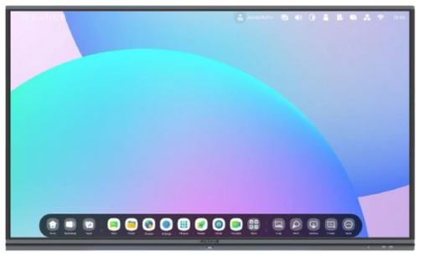
Methods of teaching
Results analysis & Pass Percentage
Degree/ Course | 2017-2018 |  |  | 2018-2019 |  |  | 2019-2020 |  |  | 2020-2021 |  |  | 2021-2022
M. Sc. (%) | 100 |  |  | 98.6 |  |  | 100 |  |  | 100 |  |  | 84
 | Distinction | First Class | Second Class | Distinction | First Class | Second Class | Distinction | First Class | Second Class | Distinction | First Class | Second Class | Distinction | First Class | Second Class
MBF | 84.6 | 7.7 | 7.7 | 73.3 | 20.0 | 6.7 | 88 | 12 | - | 100 | - | - | 52.6 | 26.3
CAMB | 44.4 | 27.8 | 27.8 | 61.1 | 27.7 | 11.2 | 58.8 | 29.4 | 11.8 | 64 | 36 | - | 72.7 | 27.2
MBT | 50 | 50 | - | 43.7 | 50 | 6.3 | 33.3 | 38.8 | 27.9 | 71.4 | 21.4 | 7.2 | 33.3 | 50

Slide 34
Mentor/Mentee System
10 students on an average per teacher
Mentoring is done once in ten days
Mentor Mentee Report.pdf

Slide 35
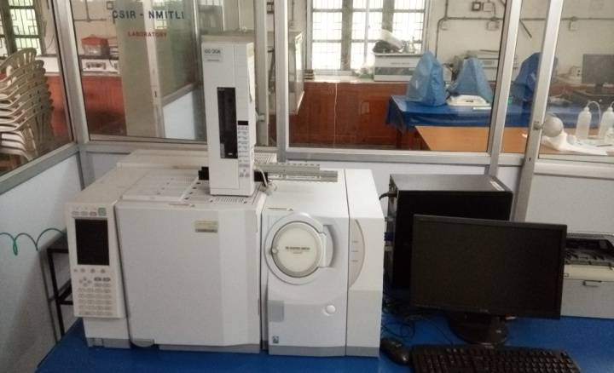
Number of JRF/SRF/PDF/RA : 3 (JRF-1, SRF- 1 & PDF-1)
Research Facilities : Labs equipped
GCMS
Fluorescence Spectrophotometer
UV-VIS Spectrophotometer
Freeze Dryer
Stereoscopic Microscope
Gel-Doc

Slide 36
Research Laboratories
WATER & SOIL ANALYSIS LABORATORY :
MICROBIOLOGY LAB :
RT PCR LABORATORY :

Slide 37
Number of Doctoral Research Scholars : 26
Patents/IPR : Prof. P. Janakiram & Dr. D. Sunil Kumar published “ Bioactive feed additive for Vibrio infections in crustaceans and method of preparation for the same” in 2022. Application No: 202241026455.
Code of ethics : Following the Code of ethics issued by National Research Ethics committees-2018.
.
Teachers in administrative positions :
1. | Prof. P. Yedukondala Rao | IQAC- Internal Academic Auditor | 2018- till date
 |  | Chairman, BOS, PG. Dept. of Marine Living Resources | 2019- till date
 |  | Head, Dept. of Marine Living Resources | 2016-2019
2. | Prof. P. Janakiram | Head, Dept. of Marine Living Resources | 2019 to till date
 |  | Head, Dept. of Zoology | 2022 to till date
 |  | Member, AU Central Purchase Committee & AU HUB | 2021 to till date
3. | Prof. K. Ramesh Babu | Warden Science College Hostels | 2014- 2022
 |  | Chief Warden Science College Hostels | 2022- till date
 |  | AU Assets Valuation Committee member | 2018- till date

Slide 38
Extension and out reach programmes organized and participated Photographs
Swachh Bharat Programme conducted by Dept. of MLR on 16-10-2019

Slide 39
Seminar on “ Opportunities & Challenges in Aquaculture conducted by Dept. of MLR on 12-02-2020

Slide 40
International Coastal cleanup program conducted by Dept. of MLR on 19-09-2021

Slide 41
Open House of Fishery Survey of India (FSI) Dept. of MLR on 17-12-2021

Slide 42
WORLD OCEAN DAY (Beach cleanup) program conducted by Dept. of MLR on 08-06-2022

Slide 43
Infrastructure and teaching resources:
Class rooms/ laboratories/Seminar halls : Class rooms : 6

Slide 44
Laboratories : 4
Hydrography LABORATORY :
WATER & SOIL ANALYSIS LABORATORY :
MICROBIOLOGY LAB :

Slide 45
SEMINAR HALL: 1
Computing equipment /Smart Boards :
Computers :6
Smart Boards :1

Slide 46
List of costly equipment
GCMS
Fluorescence Spectrophotometer
UV-VIS Spectrophotometer
Freeze Dryer
Stereoscopic Microscope
Gel-Doc

Slide 47
Cultural activities/Yoga participation/ Participation in games:
National Science day/ College day/ Dept. Annual Day/ Fresher’s & Fare well day.
Students and Staff participated in sports & Games.
Awards to students :
1) Ms. M. Lakshmi Sahiti awarded APSET 2020 for Assistant Professor/Lecturer
2) Mrs. M. Madhuri (CAMB Student, 2015-2017) – Dr. B. V. S. R. Murthy award for securing first
rank in M.Sc. CAMB course.
3) Ms. Sunad Praharshitha (CAMB Student, 2016-2018) - Prof. Kothapalli Ravindranath award
for securing first rank in M.Sc. CAMB course
4) Mr. G. S. NS. Vara Prasad(CAMB Student, 2017-2019) - Prof. Kothapalli Ravindranath award
for securing first rank in M.Sc. CAMB course.
5) Ms. T. Namitha (MB F Student, 2017-2019) - Prof. Kothapalli Ravindranath award for
securing first rank in M.Sc. MBF course.
6) Ms. M. Lavanya (MBF Student) – National level Para Badminton Champion
(2019 & 2020).

Slide 48
Other facilities to student : Dept. Library, RO water & Play
ground
Library Hall

Slide 49
Department library /e -resources/Wi-fi/internet facilities/Bandwidth/link to library e resources : 560
New books acquired : 120
E-content development : In the process
Maintenance of Infrastructure : Contingency grant
Students Support and Proregression:
Skill development programmes : 15
Guidance for NET/SLET/GRE and other competitive examinations: Yes
Placements : 90 %

Slide 50
Higher Education : 10%
Students council and its activities:
1)Students were counselled for their employment opportunities.
2) Counselled for improving their communication skills.
3)Counselled for improving the knowledge base

Slide 51
Prominent Alumni:
S .No | Name | Designation | Mobile | e-mail
1 | Mrs. A. Shantha Kumari | Chief Secretary -IAS, Telangana Government
2 | Dr. Joyce | Director, MPEDA
3 | Dr. Y. Tulasi Varma | IRAS- FA & CAO(T), | 09437097002 0694-2743998(O)
4 | M. Srinivas | Commissioner, Indian Customs, IRS | 9491882825 | srinnoo@gmail.com
5 | P. Santhram | IG, IRS
6 | Raju Gorinta | USA Defense services | 001-647-832-7258 | gorinta@gmail.com
7 | Dr. P. V. S. V. Prasad Rao | Aquaculture Industrialist | 9393127612 | indoaquatechnologies@gmail.com
8 | Dr. B. K. Sairam | Aquaculture Industrialist | 9848192970 | sairam_borra@yahoo.co.in
9 | G. Ravi Sekahar | Technical Director, BMR Group of Companies | 09884032946 | ravisekhar_g@rediffmail.com
 | B. V. N. Sunil Kumar | Aquaculture Industrialist | 9849795203 | sunilcpaqua@yahoo.co.in
10 | G. T. Naidu | Managing Director
11 | Mr. K. Janakiramayya | Managing Director, J. K. Hatcheries | 9848976668 | janakiramjk14@gmail.com
12 | Dr. A. Venkateswara Rao | General Manager, Neospark Drugs and Chemicals | 9440192787 | drvenkataannam@gmail.com dravrao2neospark.co.in
13 | M. Siva Prasad | General Manager, CP Prima | 9618661155 | sivacppindia2013@gmail.com
14 | Dr. L. Jayasree | Principal Scientist, ICAR-CMFRI, Regional Center, VSP | 8309552522 | lokasree@gmail.com

Slide 52
Governance, Leadership/Management :
Conferences /workshop attended : 219
FDPs attended : 21
Academic Audit : Internal Academic Auditors
Quality Audit : IQAC
ISO Records : ISO 9001:2015

Slide 53
Institution values and Social responsibilities:
Gender Sensitization : Women’s Grievance Cell
Anti ragging : Committee formed
Waste Management : Preparation of organic manure.
Water conservation : Constructed water Harvesting pits
Green Campus : Tree Plantation
Friendly environment for Disabled : Yes
National Events : National Science day, Independence day, Republic day, National Fish farmers day, Environmental day, Ocean Day etc.,

Slide 54
Future Plans:
Development of E-course in marine sciences and aquaculture.
2. To introduce certificate course in Sea food processing.
3. To develop five year integrated course in Fishery Science (M. F. Sc.).
4. To develop breeding and culture technology for alternate candidate species
(Eleutheronema tetradactylum and Peneaus semisulcatus)
Eleutheronema tetradactylum
Peneaus semisulcatus

